Slide 1

Blast furnace system design
OrangeCells Lab
Product document
SHIVANAGOUDA R PATIL
Senior Software Engineer
10SP.GITHUB.IO
+91 7975 113388
11.04.2023

Slide 2
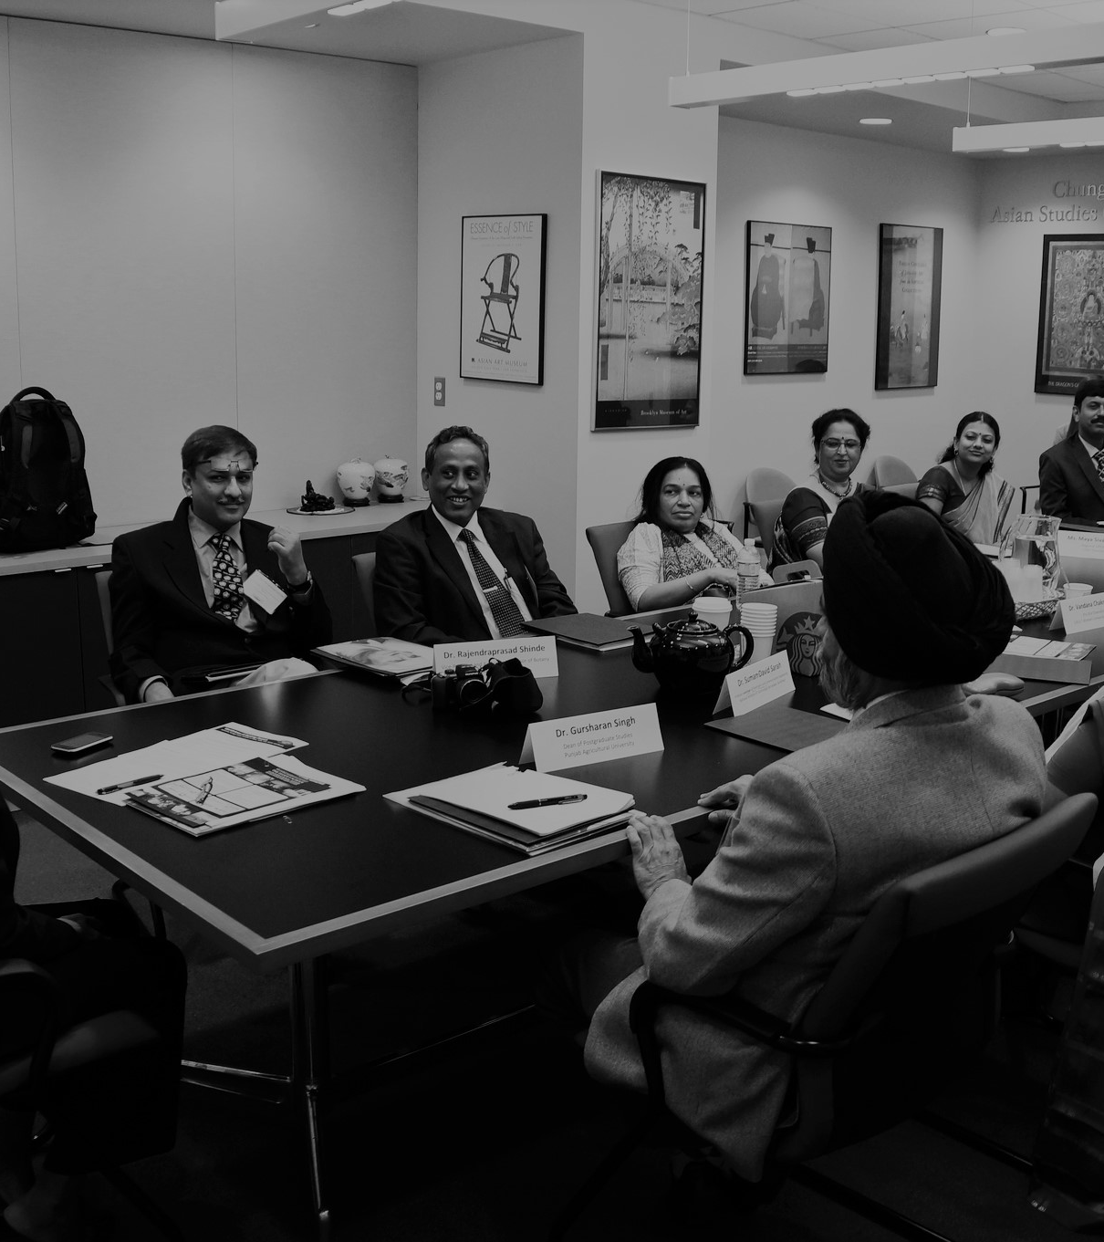
Agenda
Problem Statement.
One word Solution.
The task given to me.
Solution.
IoT Arch.
Possible wireframe screen.

Slide 3

Problem statement
Let’s Dive In

Slide 4
Assume that we at OrangeCells Lab are working with a steel plant who has a number of blast furnaces for smelting iron ores. The furnaces have a refractory inner lining that helps withstand and maintain high temperatures inside the furnace for the purpose of smelting ores. Depending on the furnace type and refractory quality, the corresponding lining material is expected to withstand temperature to a certain range. During regular operation of the furnace, the refractory lining faces wear and tear due to a number of factors such as abrasion, turbulence, sudden temperature variation, etc which may lead to leakage in the refractory lining. Hence there is a need to regularly monitor the lining temperature and plan for possible maintenance/replacement of the lining.

Slide 5
At present, most of this monitoring is a manual process, sometimes involving visual inspection. In order to minimize dependence on manual and visual methods of inspection, and to help optimize the productive use of the lining - which will result in cost savings and safety for our customer, we will develop a solution for them to continuously monitor the temperature of the lining and alert them in case of any deviation.

Slide 6

One word solution
Automation
Solving with means of automation
Leveraging Machine learning algorithms, time series databases, arrays, and linked lists.
Some scripting of microcontrollers and sensors.
Setting up web IOT API endpoint infrastructure.
Process Engineering
I believe that manual and visual methods of inspection are outdated and can be replaced with automated solutions. I also think that implementing an AI algorithm to monitor and detect temperature variations and cracks is a great approach that will help the steel plant save money and increase safety. It's about time that we leverage the power of technology to optimize these types of industrial processes.
This Photo by Unknown author is licensed under CC BY-SA-NC.

Slide 7
Task given
Let’s Dive In

Slide 8
Design an algorithm in order to:
Monitor the temperature of a blast furnace/lining surface in real time
Alert when the temperature goes out of the specified range
Alert when the lining begins to form a crack
Produce daily/weekly/monthly reports for individual furnaces

Slide 9
Lets solve it
How it works?

Slide 10
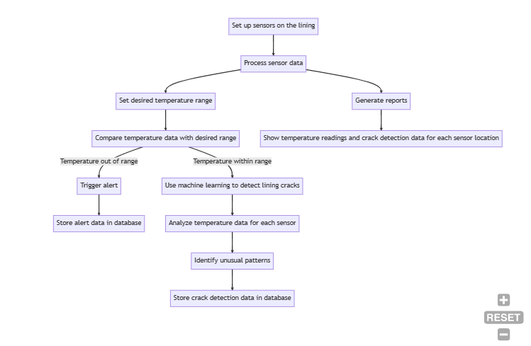

Slide 11
1. Set up sensors at various locations on the surface of the lining of the blast furnace. └──> Continuously monitor the temperature of the lining and send the data to the signal processor. 2. Use the signal processor to process the temperature data received from the sensors. └──> Convert the raw sensor data into easily interpretable data. 3. Set the desired temperature range for each furnace. 4. Continuously compare the temperature data received from the sensors with the desired temperature range for each furnace. └──> If the temperature goes out of the specified range, trigger an alert. └──> Store the alert data in a database. 5. Use machine learning algorithms to detect if the lining begins to form a crack. └──> Analyse the temperature data for each sensor. └──> Identify any unusual patterns that may indicate the lining is cracking. └──> Store the crack detection data in a database. 6. Generate daily, weekly, or monthly reports for each furnace based on the data stored in the database. └──> Show the temperature readings and crack detection data for each sensor location. This flowchart represents the algorithm designed to continuously monitor the temperature of the blast furnace lining, detect cracks, and generate reports.

Slide 12
Data Structures
Lets define em all

Slide 13
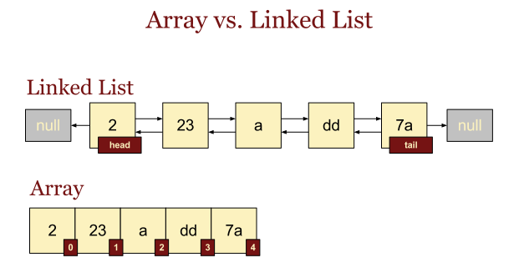
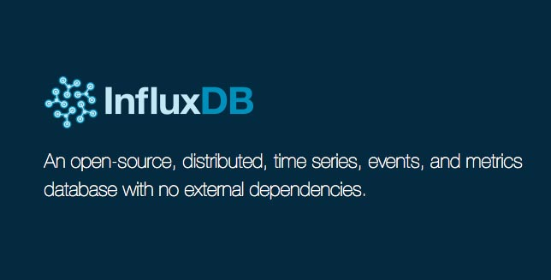
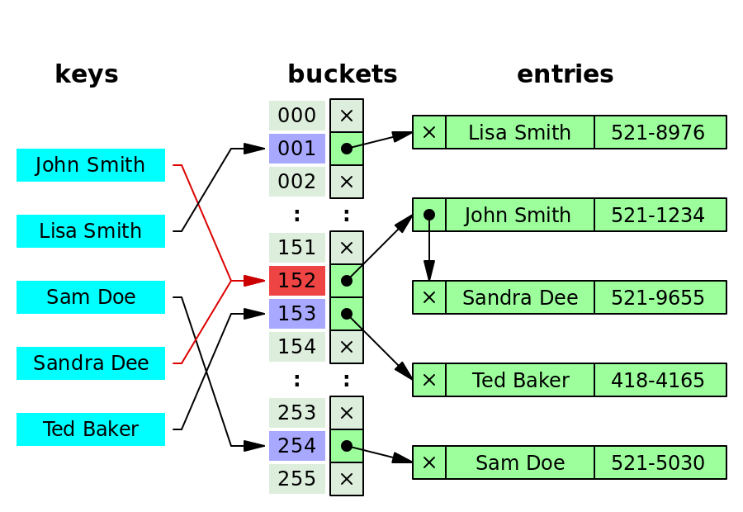
Data is of type Time series More specifically Data Structures: Arrays: to store the temperature and crack data for each furnace. Linked lists: to store the time-stamped data generated by the sensors. Hash maps: to store the temperature range and crack size limits for each furnace. A more convenient solution is influx db

Slide 14
efficiency
Let’s rev it up

Slide 15
Efficiency: The algorithm is efficient in terms of both space and time complexity since it involves the use of simple data structures and real-time processing of sensor data.

Slide 16
Database schema
Let’s Draw and normalize

Slide 17
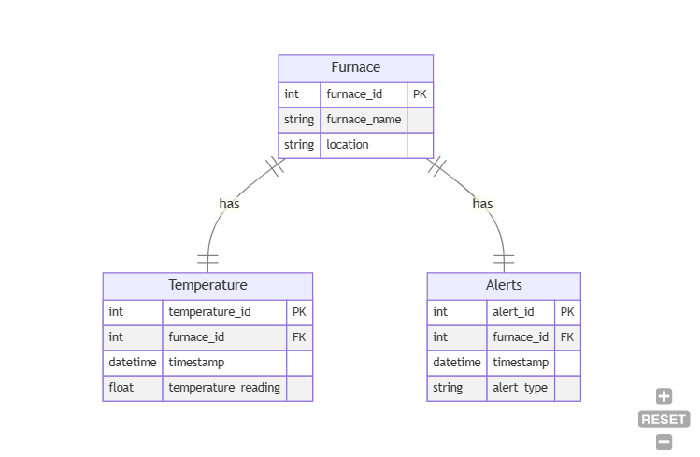

Slide 18
Problems
& mitigations

Slide 19
Possible problems and mitigations: One possible problem is the accuracy of the temperature sensors over time. To mitigate this problem, regular calibration of the sensors can be done. Another problem is the false detection of cracks due to sensor errors. To mitigate this problem, machine learning algorithms can be trained using a large dataset to improve the accuracy of crack detection

Slide 20
IoT architrecture
layerwise

Slide 21
1.For a blast furnace monitoring system, the IoT architecture would need to be tailored to the specific requirements of monitoring the operation of a blast furnace. 2.The perception layer would consist of various sensors to collect data on the temperature, pressure, gas composition, and other relevant parameters within the blast furnace. This data would be transmitted through a reliable network layer to the application layer, where it would be processed and analysed. 3.The application layer would include algorithms and models to process the data collected from the sensors, detect abnormalities or deviations from normal operation, and provide alerts and recommendations to operators or maintenance personnel. This layer may also include a user interface for visualization of the data and control of the system. 4.Security and safety are critical considerations in the design of a blast furnace monitoring system. The IoT architecture would need to incorporate robust security measures, such as authentication and authorization protocols, encryption, and secure communication channels, to prevent unauthorized access or tampering with the system.

Slide 22
Wireframes
Lets see how it looks

Slide 23
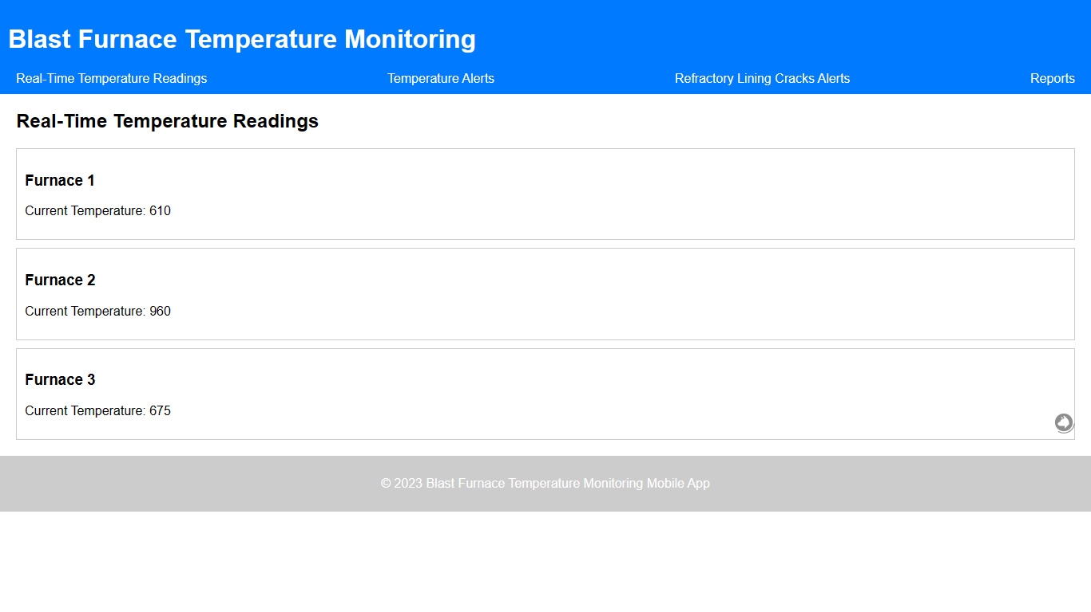

Slide 24
demonstartion
Lets see how it looks and works

Slide 25
🔻 Blast furnace monitoring system.zip🔻 download and extract open terminal in the folder and
python –m http.server 88

Slide 26



THANK YOU
Shivanagouda. R. Patil
+91 7975 113388
Shivpatil@PM.ME
Peace OUT..!

